Slide 1
Customer Problem Approach
By
Vinoth

Slide 2

About ME:
Own Site : https://huntdatascience.wordpress.com
Git hub : https://github.com/vinothhunt/
Hacker Rank : https://www.hackerrank.com/vinoth96_btech
70-461 Querying Microsoft Sql Server 2012 / 2014
70-774 Perform Cloud Data Science with Azure Machine Learning
70-775 Perform Data Engineering on Microsoft Azure HDInsight – Bigdata
Participating various hackathon from Analytics Vidhya, Kaggle and CTS

Slide 3
Agenda
Technology and Tools
Customer Problem
Feature Extraction
Feature Analysis and Importance
Model Building
Evaluation Techniques
Model Quality

Slide 4
Technology and Tools:
Language : Python
Database : Hadoop & SQL & Azure
Tools : Jupyter notebook & Pytorch
ML Models : Supervised & Unsupervised (Linear Regression, Logistic Regression, Decision Trees, Random Forest, Clustering, Gradient Boost & XGBoost, kNN, NLP,CNN. Neural Network)
Visualization : Tableau
Domain : Healthcare & Finance

Slide 5
What is Risk Classification?
Identifying the member health risk based on various condition and classified as LOW and High Risk
Business Problem: Organization need to improve the revenue profit for member specific, in order to addressing the high claim value
Regularly government fund to member for specific criteria(Medicaid /Medicare)

Slide 6
Risk classification Derivation
Member Risk is something that needs to be computed
Feature Extraction – Age, Revenue, customer predefined ill measure, Claim and Campaign results
Low Risk
Member
0
1
High Risk

Slide 7
Model Building Steps
Load the data
Exploratory Data Analysis
Pre-process the data – Data cleaning and Data conversion
Feature Analysis & Extraction
Categorical encoding
Model fitting & Hyper-parameter tuning
Pick the best
Evaluate with new data

Slide 8
Evaluation Metrics
Needed to select the best
Assess our model in terms of result
Provides Reliability to the model
Our Evaluation metrics – ROC AUC & F-Score

Slide 9
F-Score & ROC AUC
F-Score helps to evaluate both model performance and accuracy
Better measure for imbalanced data
ROC evaluates the misclassification of the model
ROC provides the better cut-off value to convert probability to decision
AUC helps to choose the best model for our requirement

Slide 10
Model Selection
Model | ROC AUC Metrics | F-Score
Logistic Regression | 61.06% | 50%
Lasso classification | 61.9% | 59%
Ridge Classification | 61.1% | 50%
Decision Tree | 73.1% | 69%
Random Forest | 71.7% | 678%
AdaBoost | 70.6% | 66%
Light Gradient Boost | 84.1% | 75%

Slide 11
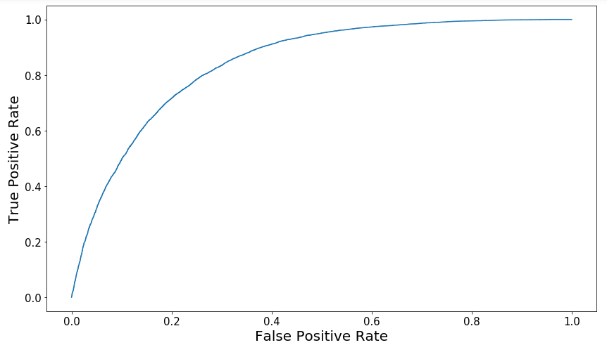
Model Metrics
ROC AUC – 84.1%
F-Score – 75%

Slide 12
Model Quality
Cross validation makes our model robust
Stratified technique helps our model to overcome sample bias
Parameter tuning helps our model to pick the right number for our data
Good ROC AUC value makes our model reliable

Slide 13

Any queries?

Slide 14
Thank you

